Slide 1
Application: QuickDoc Type: Application Architecture View: Logical View Style: Layered Architecture Pattern
← Users →
← Delivery Channels →
← Core Business Processes →
← Data And Information →
← Technology Enablers →
Authentication
& Authorization
User Profiles
Payment Gateway
(Stripe/PayPal)
Appointment
Management
Doctor Profiles
Email/SMS
Notification
Patient
Web Browser
(Desktop/Mobile)
Appointment Data
Doctor Search
& Discovery
Clinical Labs
Integration
Payment
Processing
Payment Records
AWS EC2
Cloud Hosting
Doctor
Reviews Data
Reviews &
Ratings
GitHub &
Jenkins CI/CD
Availability
Schedules
PostgreSQL
Database
Provider
Management
Medical Records
Clinic Admin

Slide 2
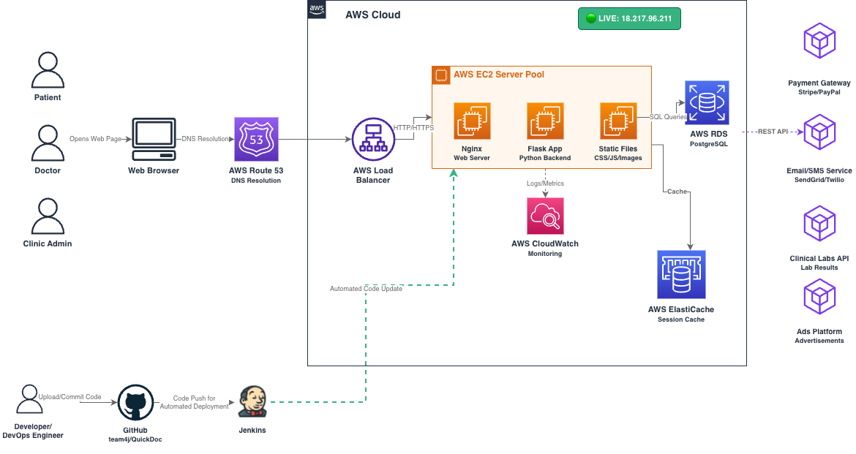
Application: QuickDoc Type: Application Architecture View: Process View Style: Client-Server Pattern (AWS Deployment)

